Slide 1


Embedding design structure in engineering information
Demonstration of software prototypes
12-13 April 2016 project meeting
Hau Hing Chau

Slide 2

Software prototypes
Embedding design structure in engineering information
Structure Embedding

Slide 3
Software prototypes
Embedding design structure in engineering information
Structure Embedding
StrEmbed-1 (March) – status: done
StrEmbed-2 (June) – status: in progress
StrEmbed-3 (November)

Slide 4
Software prototypes
Embedding design structure in engineering information
Structure Embedding
StrEmbed-1 (March) – status: done
StrEmbed-2 (June) – status: in progress
StrEmbed-3 (November)

Slide 5
StrEmbed-1 (March)
Embedding design structure in engineering information
What it does?
Use SolidWorks assemblies
Convert to STEP AP214 format
Produce a lattice file according to its assembly structure
Visualise lattice

Slide 6
StrEmbed-1 (March)
Embedding design structure in engineering information
Case studies
Five-piece puzzle in three different structures
Simplified five-part lock assembly
15-part lock assembly in three assembly levels
100-odd parts robot

Slide 7
StrEmbed-1 (March)
Embedding design structure in engineering information
Case studies
Five-piece puzzle in three different structures
Simplified five-part lock assembly
15-part lock assembly in three assembly levels
100-odd parts robot

Slide 8

Five-piece puzzle (1 of 3) – a flat structure
Embedding design structure in engineering information

Slide 9
Five-piece puzzle (2 of 3) – two levels
Embedding design structure in engineering information

Slide 10
Five-piece puzzle (3 of 3) – another two levels
Embedding design structure in engineering information

Slide 11
StrEmbed-1 (March)
Embedding design structure in engineering information
Case studies
Five-piece puzzle in three different structures
Simplified five-part lock assembly
15-part lock assembly in three assembly levels
100-odd parts robot

Slide 12
Five-part lock
Embedding design structure in engineering information

Slide 13
StrEmbed-1 (March)
Embedding design structure in engineering information
Case studies
Five-piece puzzle in three different structures
Simplified five-part lock assembly
15-part lock assembly in three assembly levels
100-odd parts robot

Slide 14
15-part lock assembly
Embedding design structure in engineering information

Slide 15
StrEmbed-1 (March)
Embedding design structure in engineering information
Case studies
Five-piece puzzle in three different structures
Simplified five-part lock assembly
15-part lock assembly in three assembly levels
100-odd parts robot

Slide 16

100 parts robot
Embedding design structure in engineering information

Slide 17
Software prototypes
Embedding design structure in engineering information
Structure Embedding
StrEmbed-1 (March) – status: done
StrEmbed-2 (June) – status: in progress
StrEmbed-3 (November)

Slide 18
StrEmbed-2 (June)
Embedding design structure in engineering information
What it does?
Visualisation
Embedding structure onto a hypercube
Limited to 5-part at this time

Slide 19
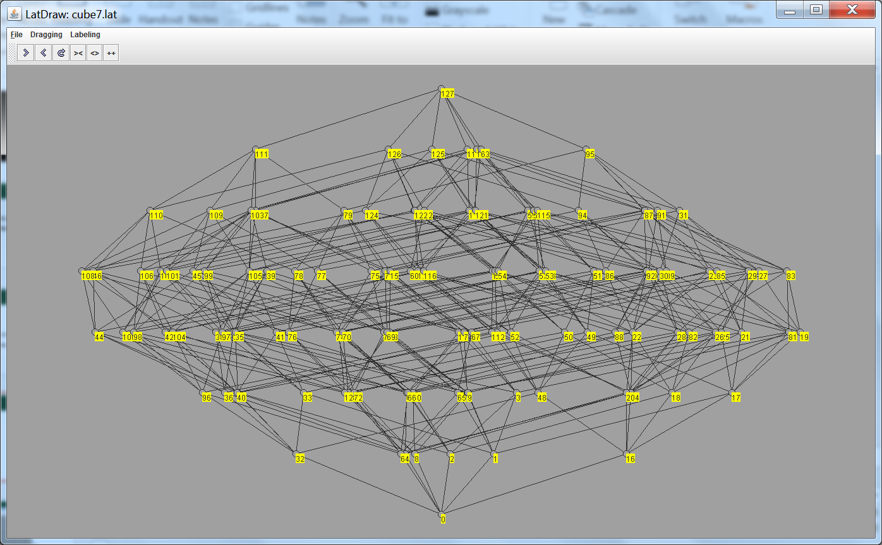
7-hypercube
Embedding design structure in engineering information

Slide 20
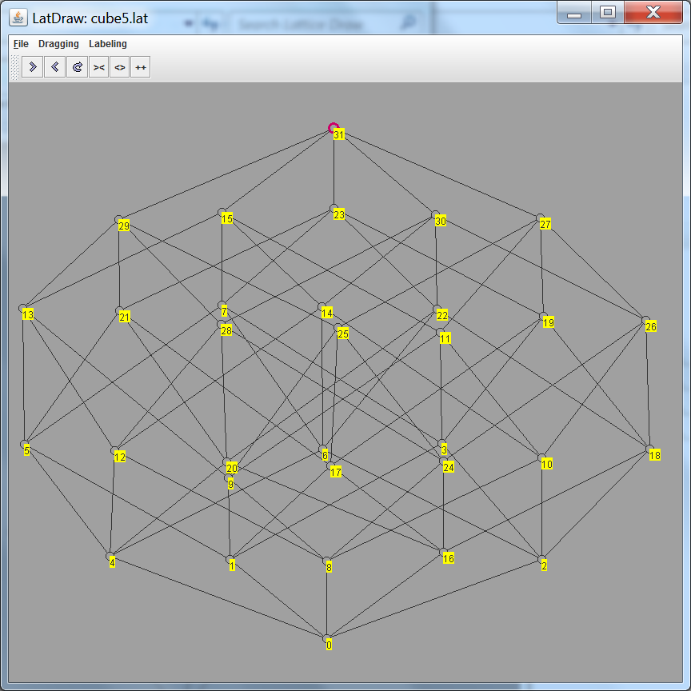
5-hypercube
Embedding design structure in engineering information

Slide 21
StrEmbed-2 – embedding an assembly on to a 5-hypercube
Embedding design structure in engineering information

